Slide 1
Computer Architecture
A Quantitative Approach, Fifth Edition
Chapter 2
Memory Hierarchy Design
Section 2.1 Only

Slide 2
Introduction
Introduction
Programmers want unlimited amounts of memory with low latency
Fast memory technology is more expensive per bit than slower memory
Solution: organize memory system into a hierarchy
Entire addressable memory space available in largest, slowest memory
Incrementally smaller and faster memories, each containing a subset of the memory below it, proceed in steps up toward the processor
Temporal and spatial locality insures that nearly all references can be found in smaller memories
Gives the allusion of a large, fast memory being presented to the processor

Slide 3
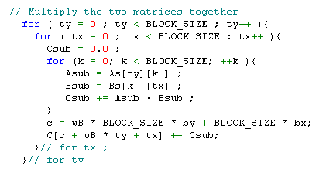
Principle of locality
Temporal locality (locality in time): if an item is referenced, it will tend to be referenced again soon.
Spatial locality (locality in space): if an item is referenced, items whose addresses are close by will tend to be referenced soon.
for-loop is temporal locality
array is spatial locality
Observation: temporal locality means that we don’t put all program into memory whereas spatial locality means that we don’t put all data into memory, hence we have “Memory Hierarchy”

Slide 4
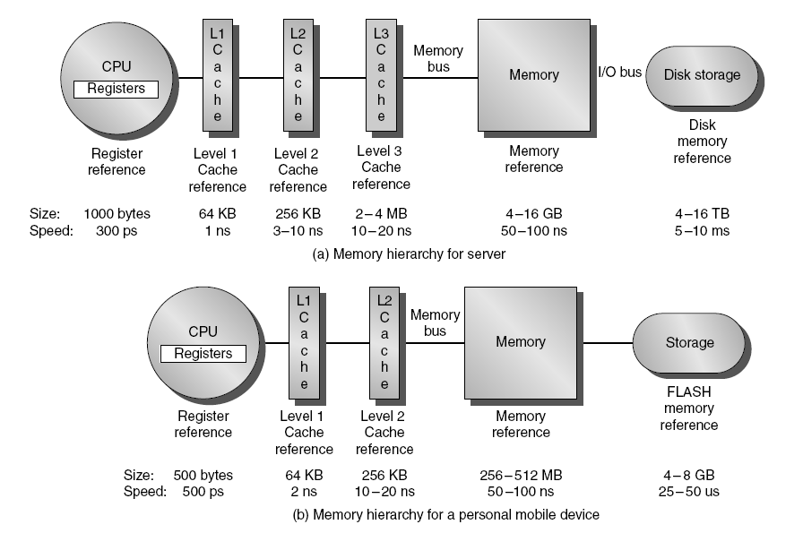
Memory Hierarchy
Introduction

Slide 5
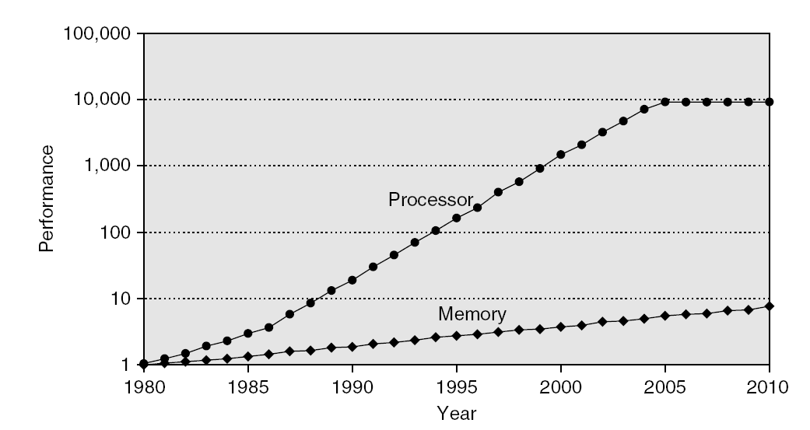
Memory Performance Gap
Introduction

Slide 6
Memory Hierarchy Design
Introduction
Memory hierarchy design becomes more crucial with recent multi-core processors:
Aggregate peak bandwidth grows with # cores:
Intel Core i7 can generate two references per core per clock
Four cores and 3.2 GHz clock
25.6 billion 64-bit data references/second +
12.8 billion 128-bit instruction references
= 409.6 GB/s!
DRAM bandwidth is only 6% of this (25 GB/s)
Requires:
Multi-port, pipelined caches
Two levels of cache per core
Shared third-level cache on chip

Slide 7
Performance and Power
Introduction
High-end microprocessors have >10 MB on-chip cache
Consumes large amount of area and power budget

Slide 8
Q & A

